Slide 1
How to use SSMS

Slide 2
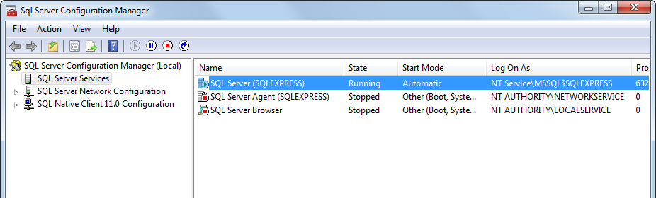

Slide 3
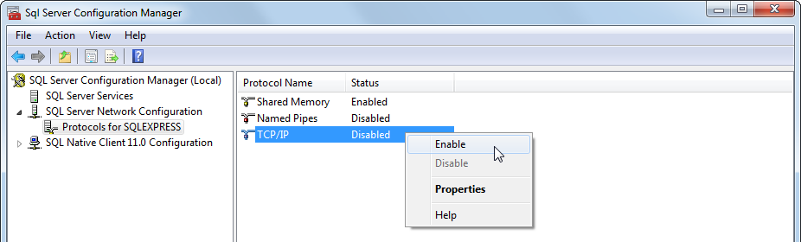

Slide 4
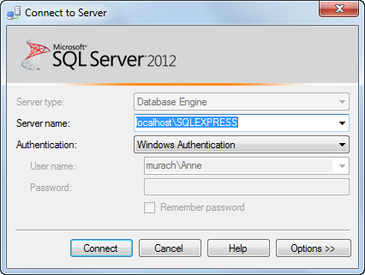

Slide 5
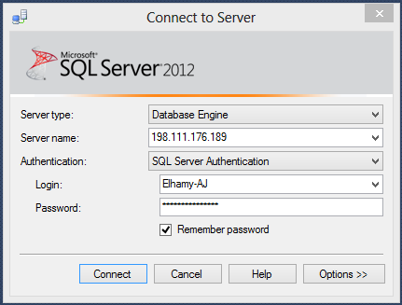

Slide 6
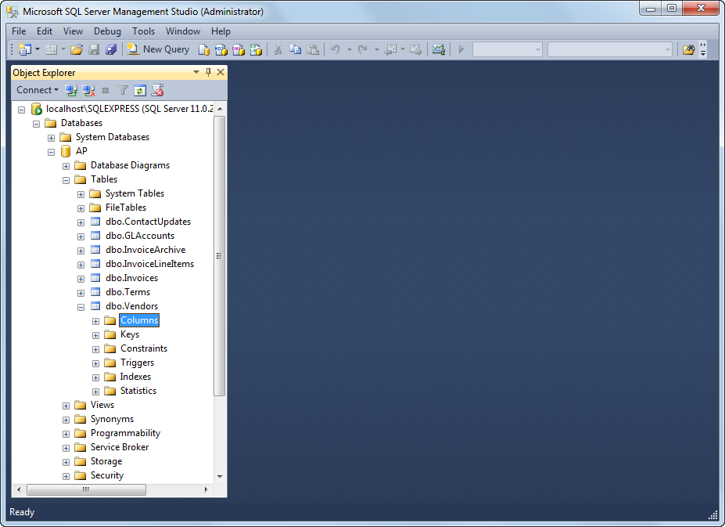

Slide 8
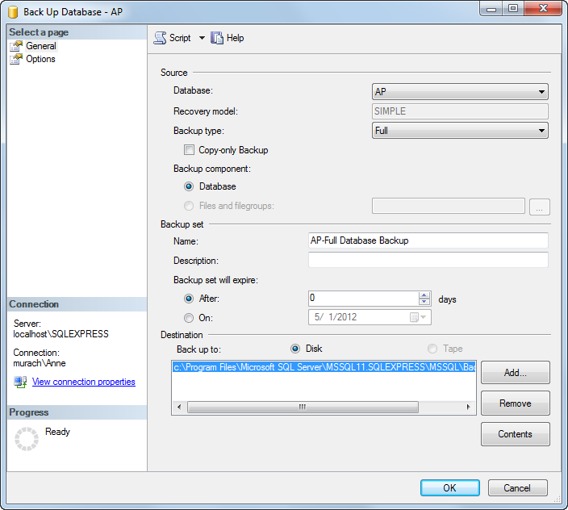

Slide 10
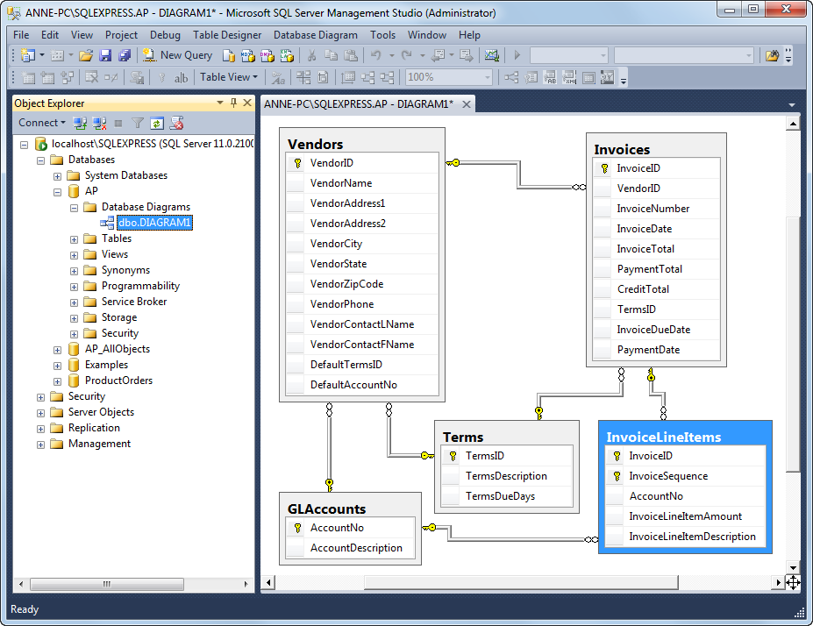

Slide 11
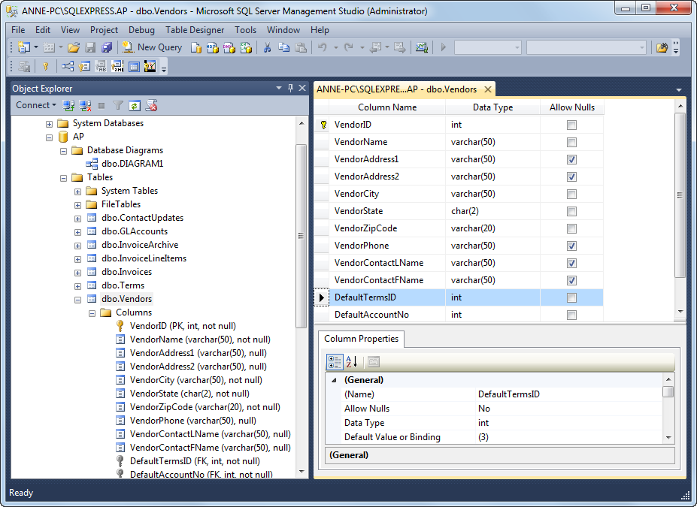

Slide 12
Tables relates by Keys:
As we discussed before, A database consists of one or more than one table. In a multi-table database, you not only need to define the structure of each table, you also need to define the relationships between each table in order to link those tables correctly.
Tables are related based on KEYs
Tables have relationship with itself or others based on the design
The most common relationship is a relationship between the Primary Key in one table and the Foreign Key in another table
The Foreign Key is nothing but a key that relates back to a PK

Slide 13
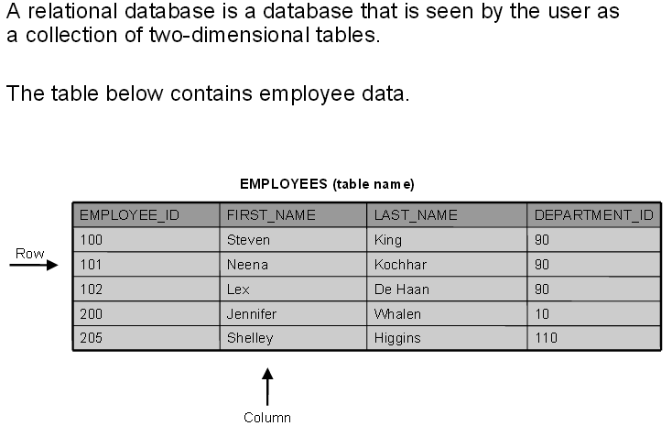

Slide 14
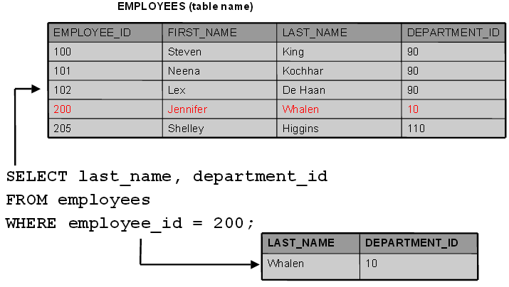
Structured query language (SQL) allows us to access data in relational databases in an efficient way. Instead of going through each row to find the record for employee number 200, we use the
following SQL statement:

Slide 15
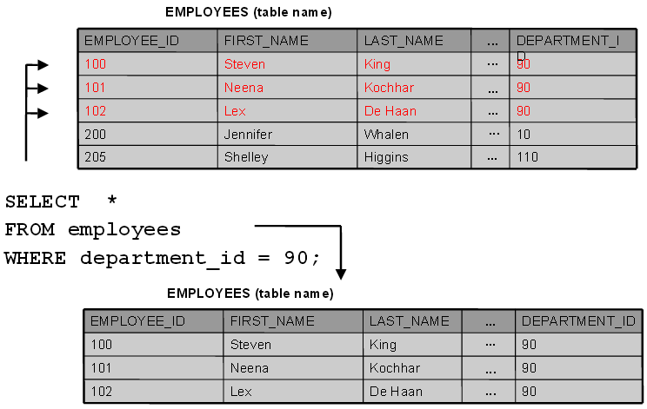
To find all the employees in department number 90, we write a different SQL statement:

Slide 16
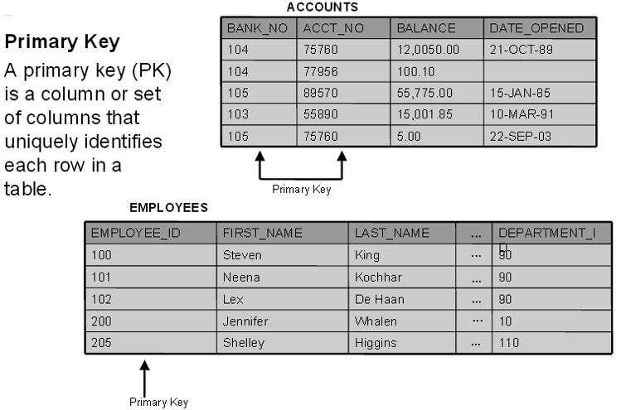

Slide 17
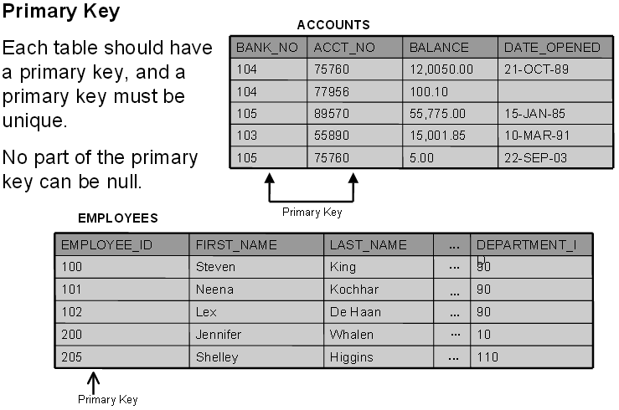

Slide 18
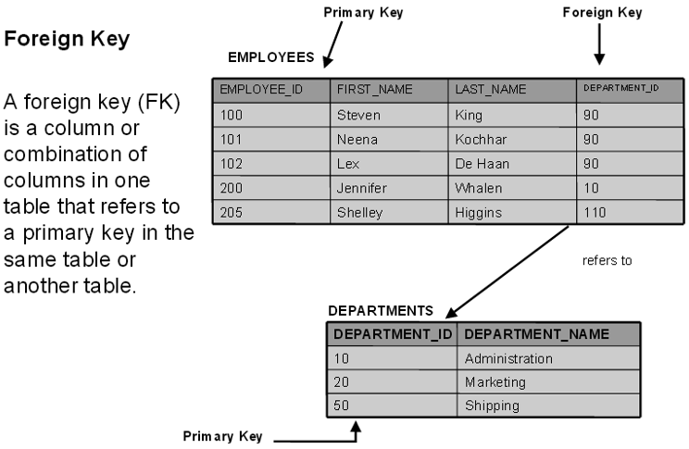

Slide 19
Summary of Data-Integrity Rules
Data-integrity rules (also known as constraints) define the relationally correct state for a database.
Data-integrity rules ensure that users can perform only those operations that leave the database in a correct, consistent state.

Slide 20
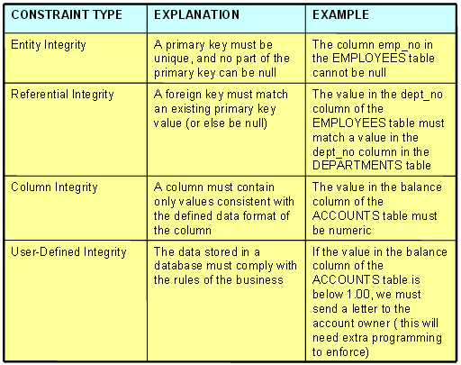

Slide 21
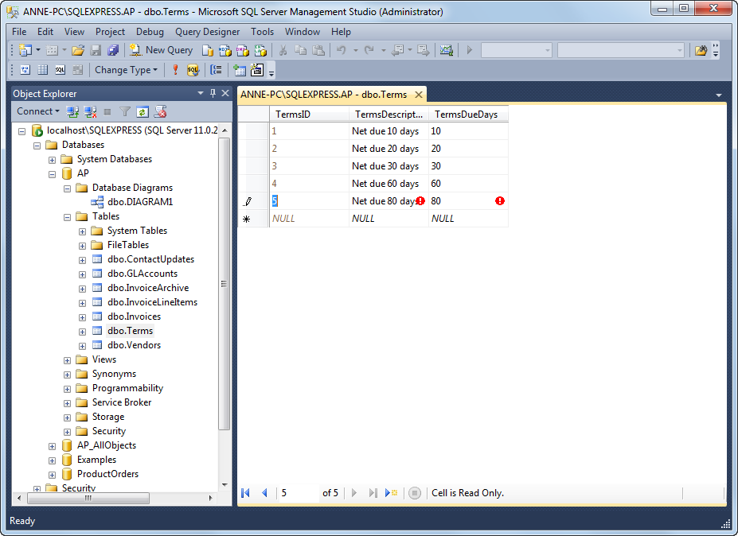

Slide 22
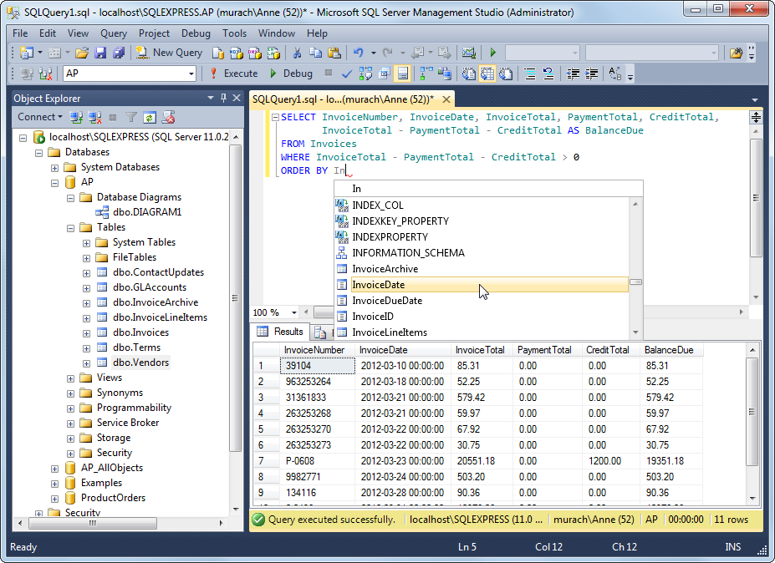

Slide 23
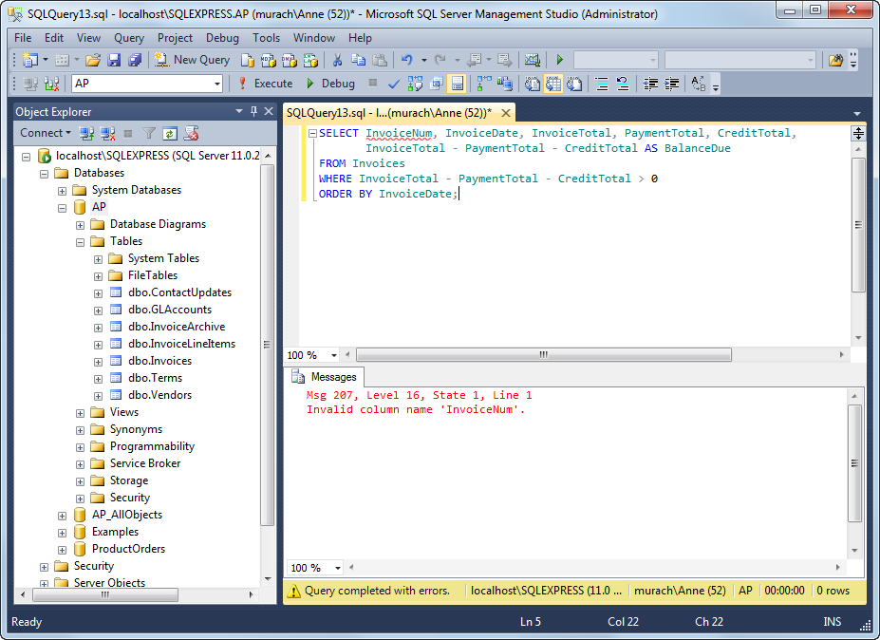

Slide 25
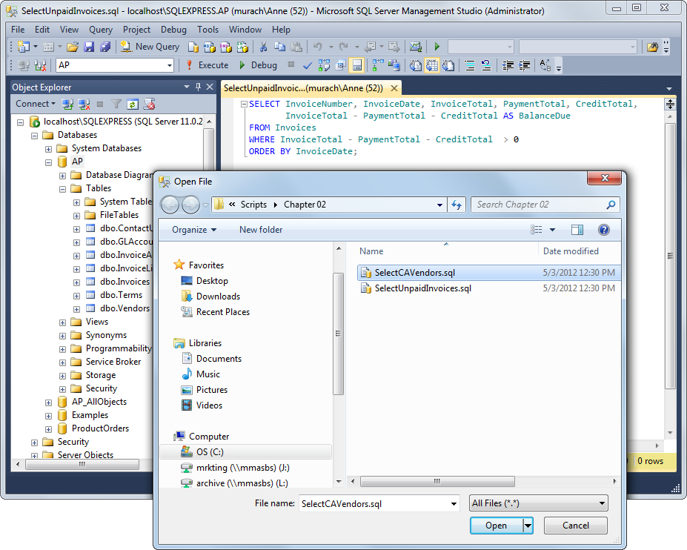

Slide 26
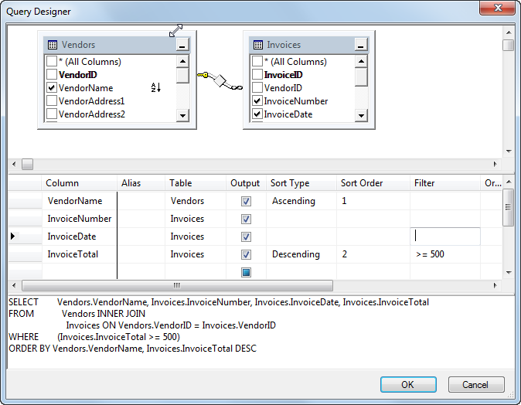

Slide 27
